Slide 1

COMP 7612 Foundations
Computer Science
CODEWORD DESIGN
Senjuti Dutta

Slide 2
Goal/Scope
To find an approximate solution of CODEWORD DESIGN problem.
DNA CODEWORD DESIGN
INSTANCE: Two integers n / 𝛕 (size of the string/hybridization stringency)
QUESTION: What is the selection of sphere centers (probes) in the DNA space such that every other string of size n is within h-distance 𝛕 of exactly one probe?

Slide 3
Lit Review
Technical Terms
Hybridization – binary operation between two single strands ‘x’ and ‘y’ that forms a double helix structure.
DNA strands – are called polynucleotides since they are composed of simpler monomer units called nucleotides.
Hybridization Stringency - is the extent to which hybridization can occur between nucleoids with mismatched sequences.
Gibbs energy - The amount of energy in terms of forming a double helix form.
h-distance – is an integer between two DNA strands ‘x’ and ‘y’ that describes the likelihood of hybridization between two strands.
When h-distance is less between DNA strands then there is high chance to hybridize between them . The larger the value of h-distance , the farther apart the strands are and they are less likely to hybridize ^{[1]}
^{[1]} Garzon, M., and V. Phan.3 (2009). On codeword design in metric spaces, Natural Computing, pp. 571-588

Slide 4
.. Lit Review
..Technical Terms
For example, when h-distance is 0 then the DNA strands are perfectly complement to each other and there is maximum likelihood of hybridization between them.
The smaller the h-distance ,the more likely are the strands to hybridize.
Suppose h –distance is 59 then there is very less chance to hybridize between two strands.
General Information of Codeword Design Problem
Requirement
Success in specific hybridization between a DNA codeword and its complement.
No hybridization between DNA codewords from same DNA or between a DNA codeword and others’ Watson-Crick complements.

Slide 5
.. Lit Review
..General Information of Codeword Design Problem
Important in DNA Computing, self-assembly, DNA memories and phylogenetic analyses.
Application
Useful to select DNA molecules in DNA computers so that they can hybridize .
DNA CODEWORD DESIGN problem is very helpful to select molecules as probe to build more powerful DNA computers.

Slide 6
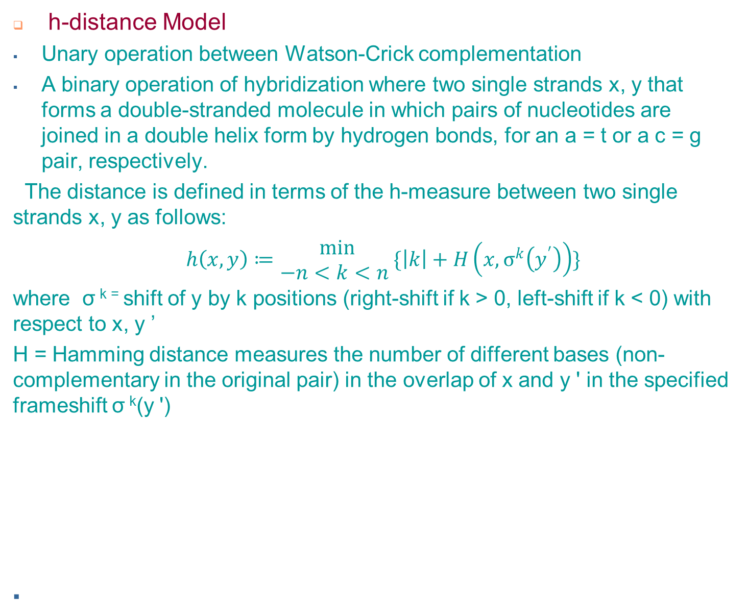
.. Lit Review
^{[2]}
^{[2]} Garzon, M. H. (2014). DNA codeword design: Theory and applications. Parallel Processing Letters, 24(02), 1440001.

Slide 7
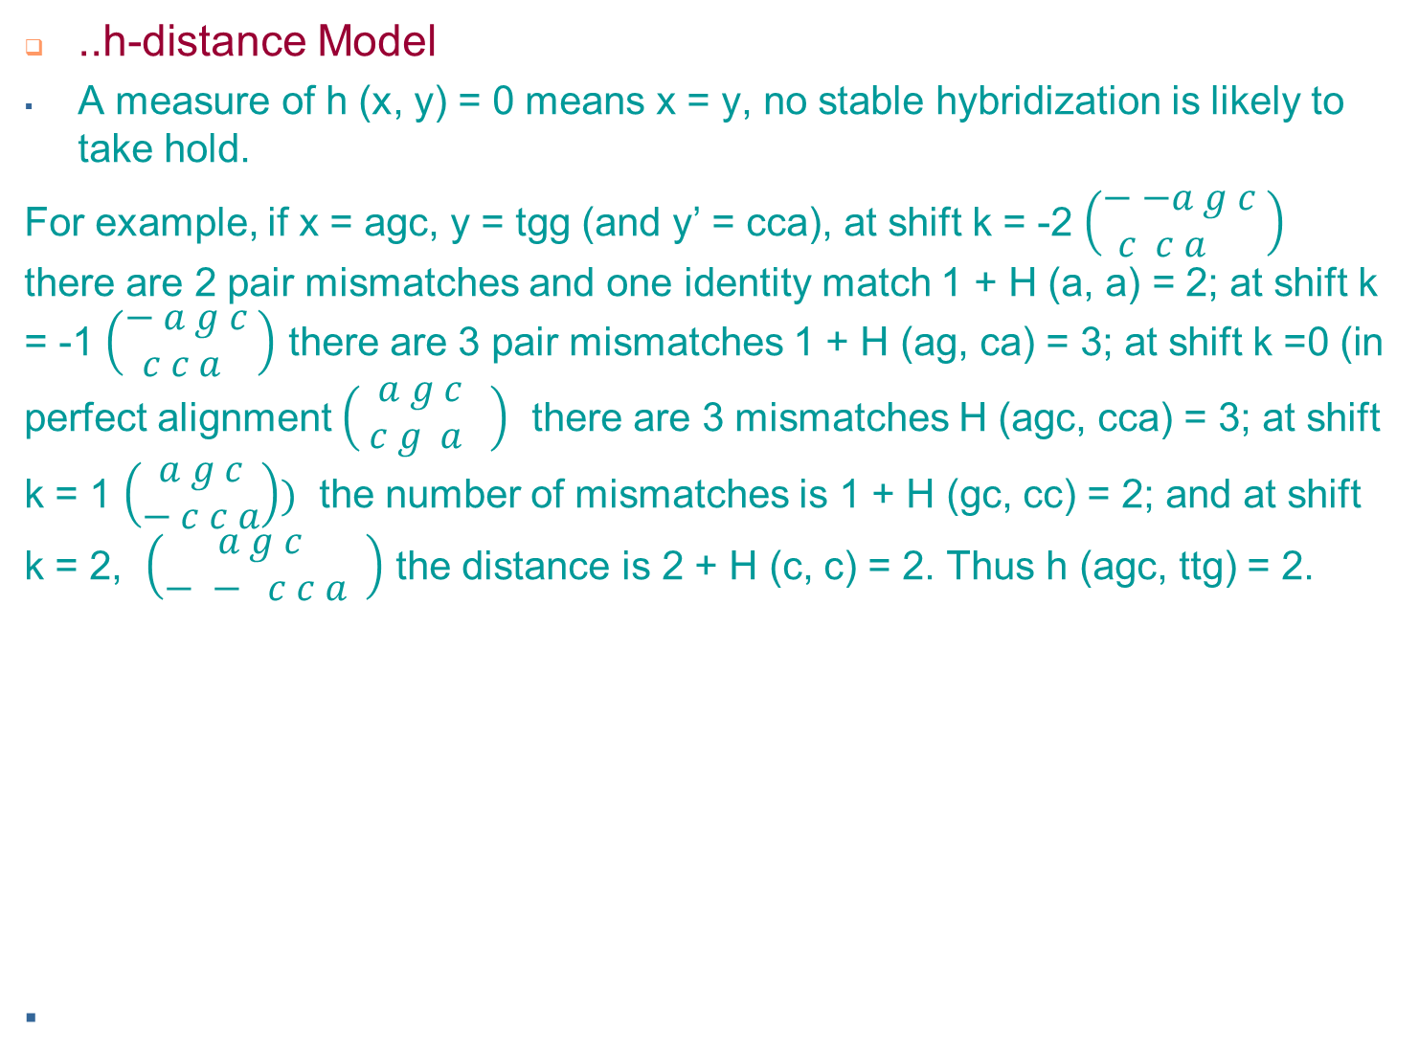
.. Lit Review

Slide 8
.. Lit Review
..h-distance Model :
Usefulness
Conceptualize type of problem , find solutions, organize knowledge about DNA CODEWORD DESIGN in a systematic manner.

Slide 9
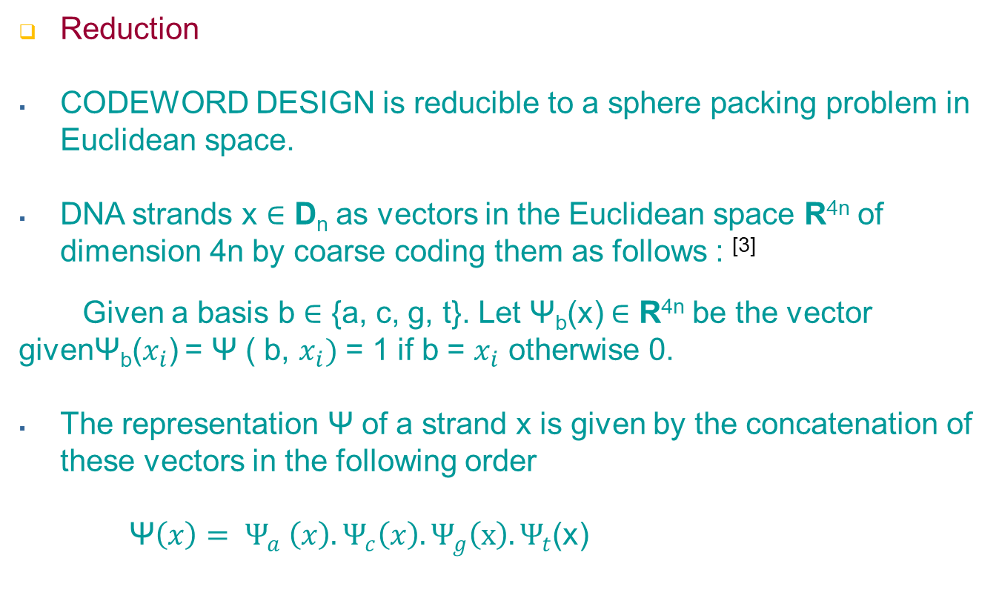
Case Study
^{[3]} Garzon, Max H., and Kiran C. Bobba 6 (2012). A geometric approach to Gibbs energy landscapes and optimal DNA codeword design, International Workshop on DNA-Based Computers Springer/Berlin, pp. 73-85

Slide 10
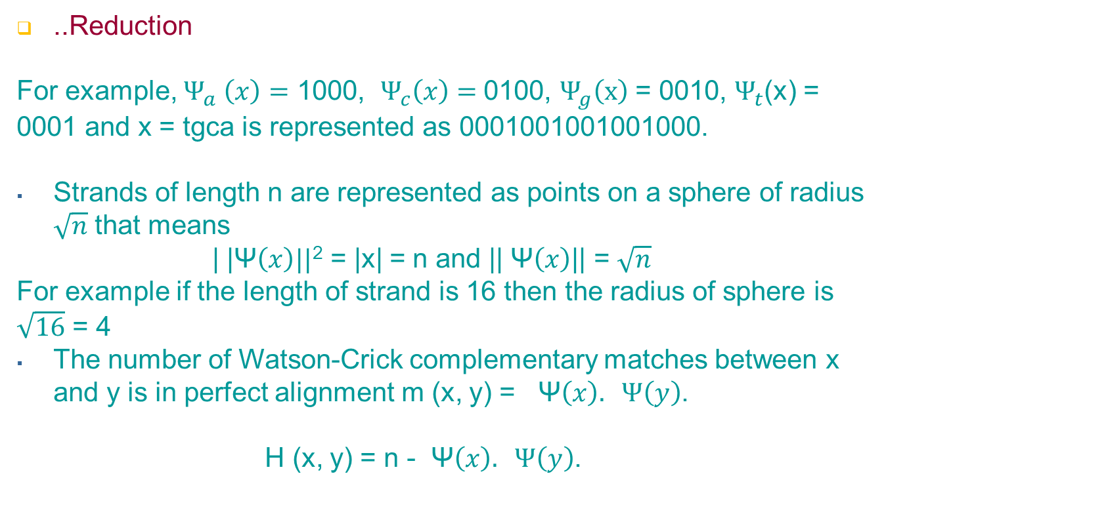
..Case Study

Slide 11
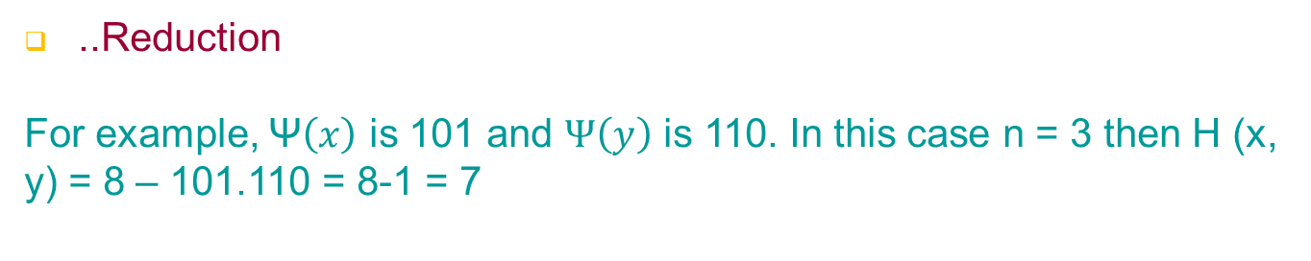
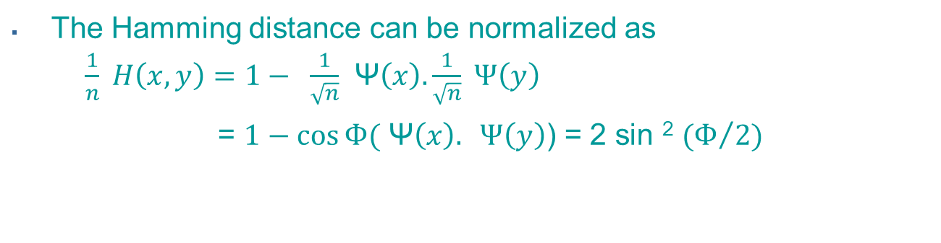
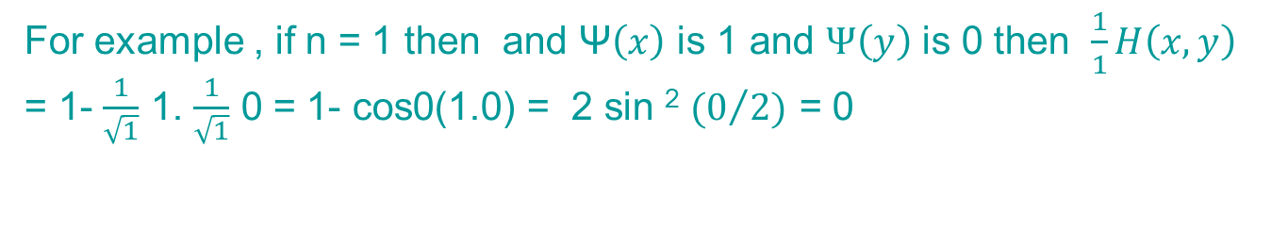
..Case Study

Slide 12
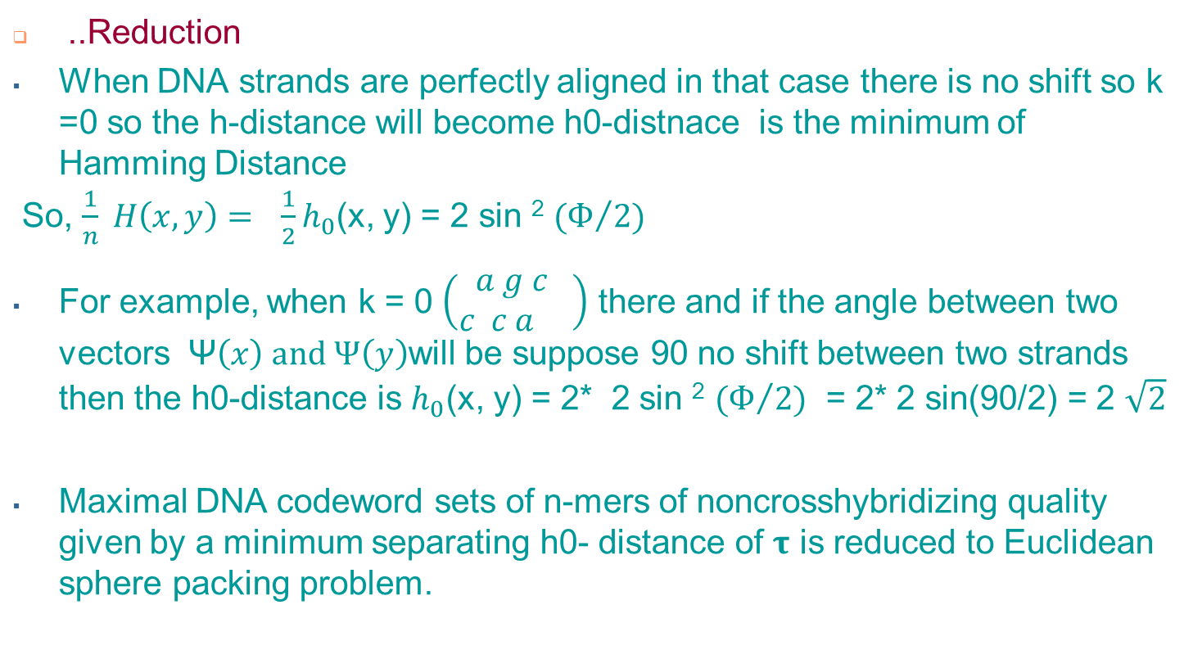
..Case Study

Slide 13
Deliverables
Approximate Solution:
Reduction of indicates solutions to EUCLIDEAN SPHERE PACKING is a solution to CODEWORD DESIGN
Solutions of EUCLIDEAN SPHERE PACKING :
n =1 is trivially solved in the line by a so-called lattice packing of unit 1D-spheres
n = 2 was proven by Gauss in the 1830s to be optimal among lattice packings
n= 3, the problem is famous for the sphere kissing problem of Newton as to the maximum number of spheres in a uniform size arrangement kissing a center sphere.

Slide 14
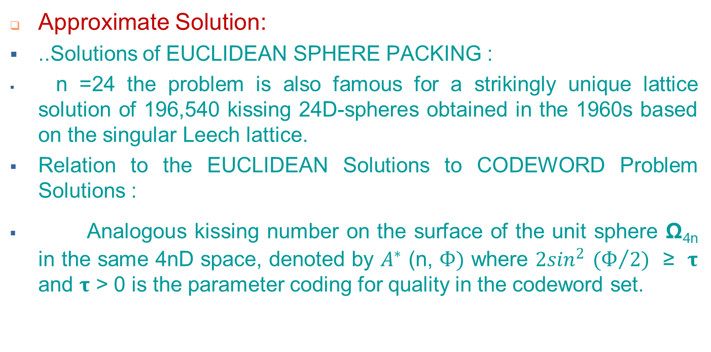
..Deliverables

Slide 15
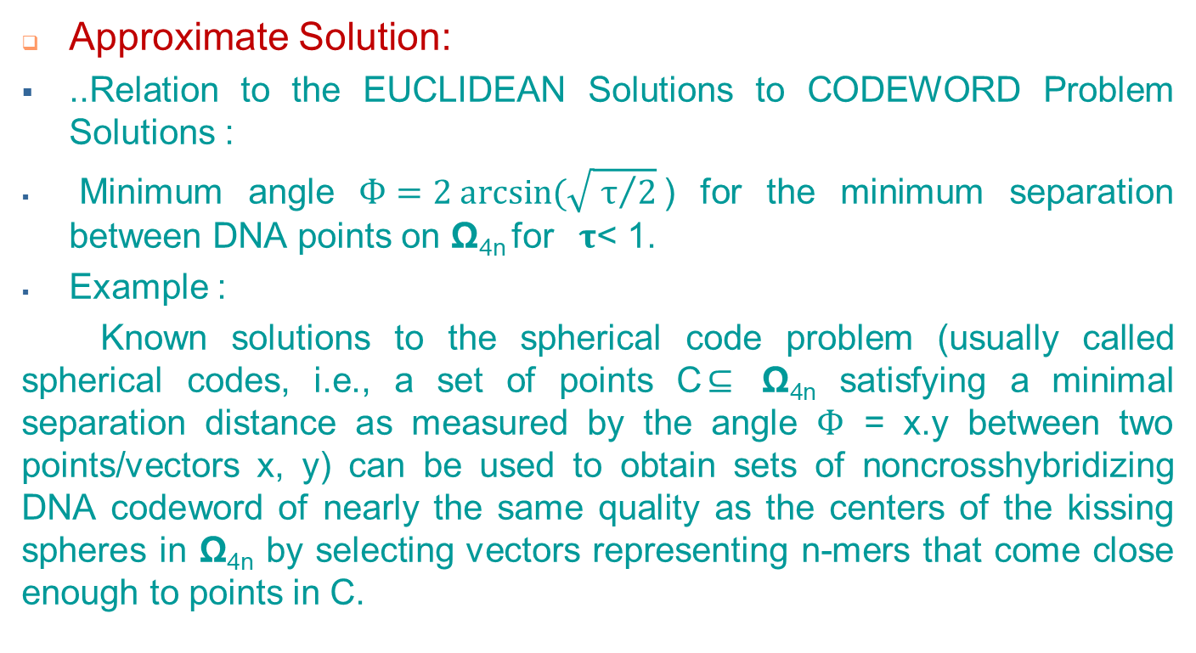
..Deliverables

Slide 16
..Deliverables
..Approximate Solution:
..Relation to the EUCLIDEAN Solutions to CODEWORD Problem Solutions :
DNA codeword set with the optimal solution for lattice packings in 24D-space (i.e., for 6-mers), the Leech lattice, 3-error correcting code in 24D Hamming space and is known to have a separation angle of arccos (1/3) ≈70°.
Decompose the lattice points in 4D-space into nearly concentric layers (usually referred to as shells) around one of its points located as origin (perhaps after a translation.)
The points in this shell are then projected onto Ω_{4n} by dividing by their norm.

Slide 17
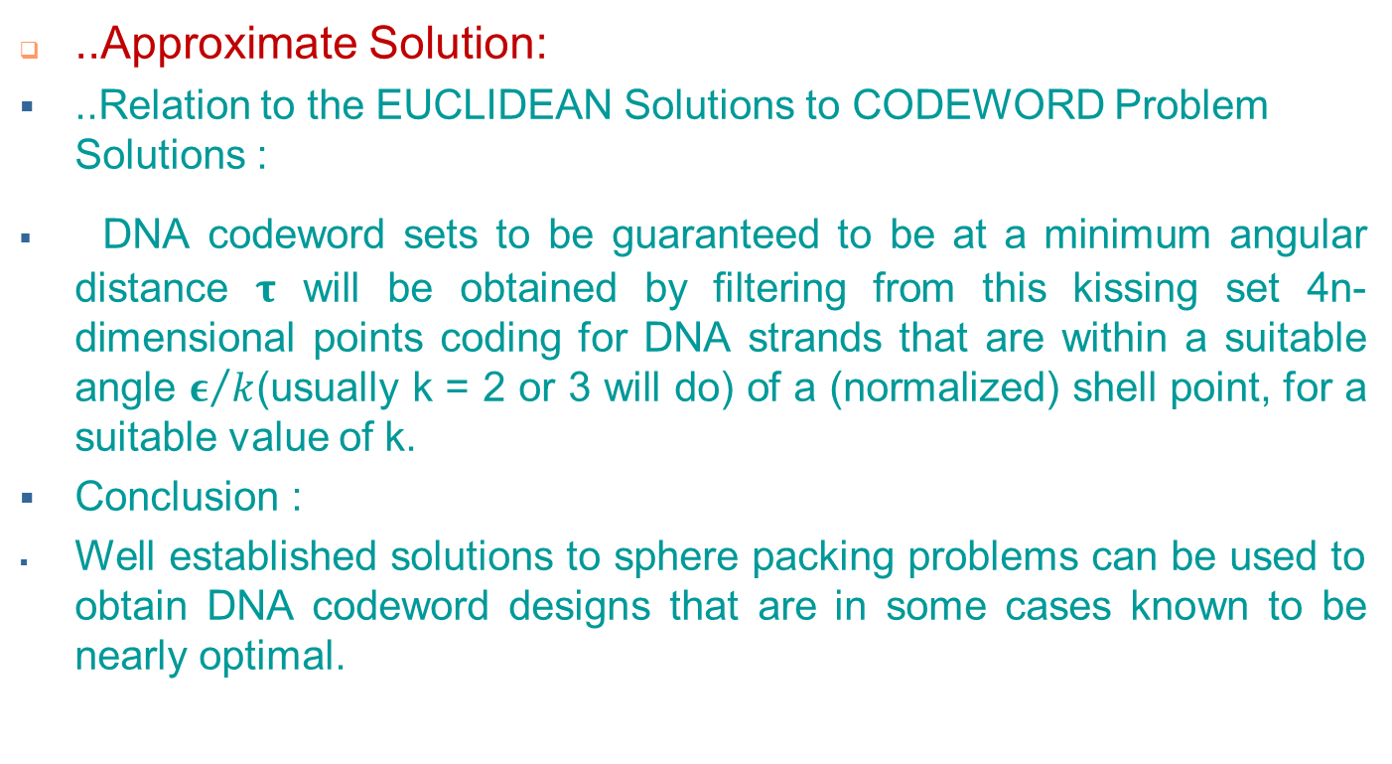
..Deliverables

Slide 18
..Deliverables
..Approximate Solution:
.. Conclusion :
Inclusion of upper and lower bounds dependent on estimation of the size of optimal codes for dimensions up to 128-mers in DNA Space.
Solutions include some infinite families of DNA strand lengths, based on estimates of the kissing (or contact) number for sphere packings in Euclidean spaces.

Slide 19
..Deliverables
Proof of correctness of reduction
Main factors in proof
Needs decision version of the algorithmic problem
Is correct if reduction of one instance is transformed to another instance and answers to the decision questions are same always.
Always get answers “YES” from both of the decision version of Algorithmic Problem (AP) for positive instance and always get answers “NO” for negative instances

Slide 20
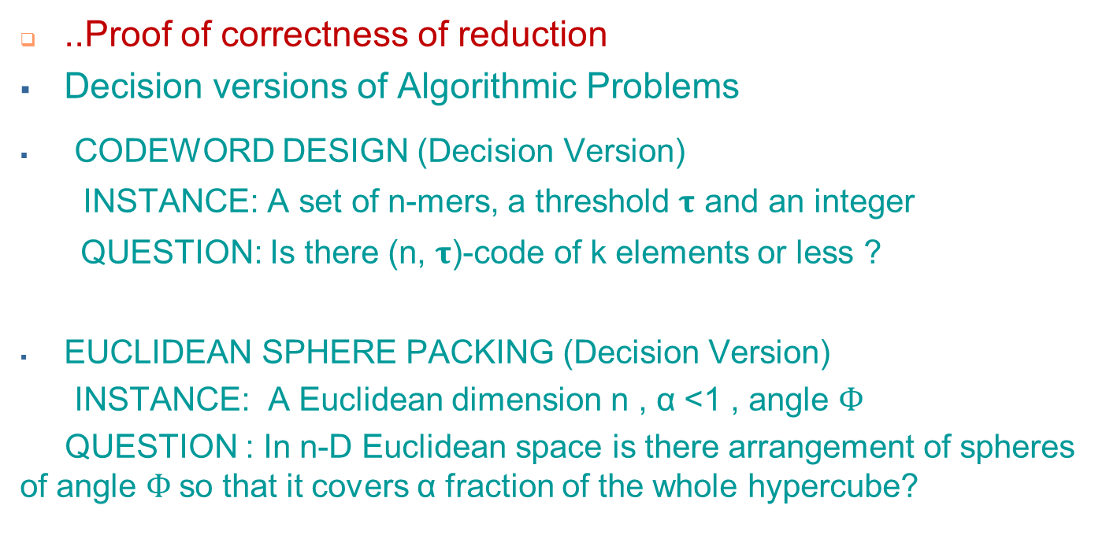
..Deliverables

Slide 21
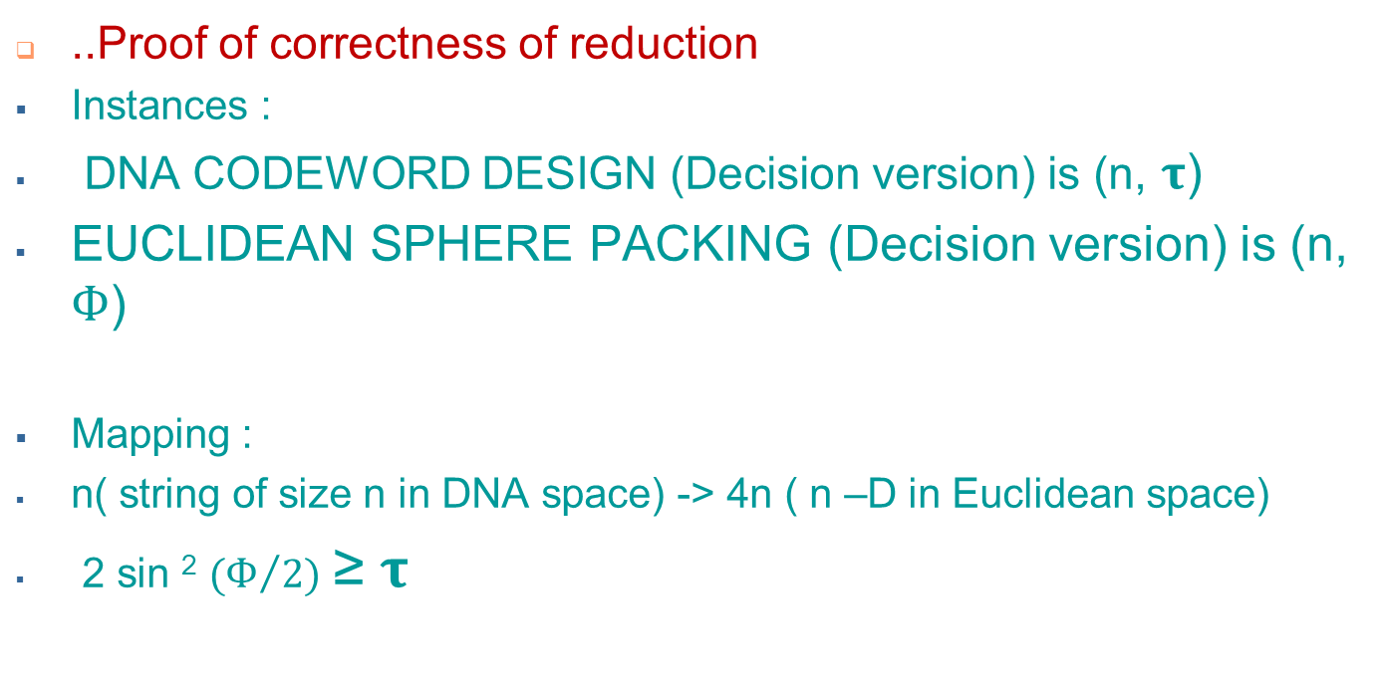
..Deliverables

Slide 22
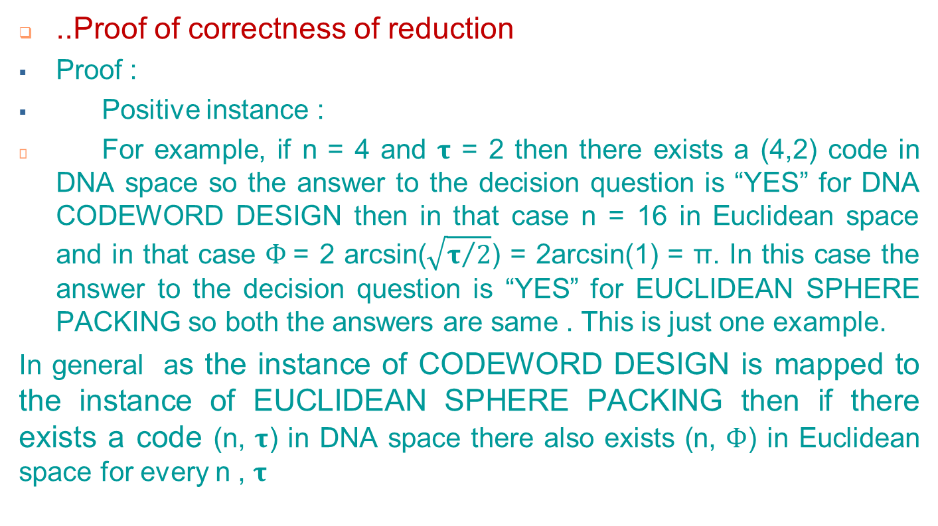
..Deliverables

Slide 23
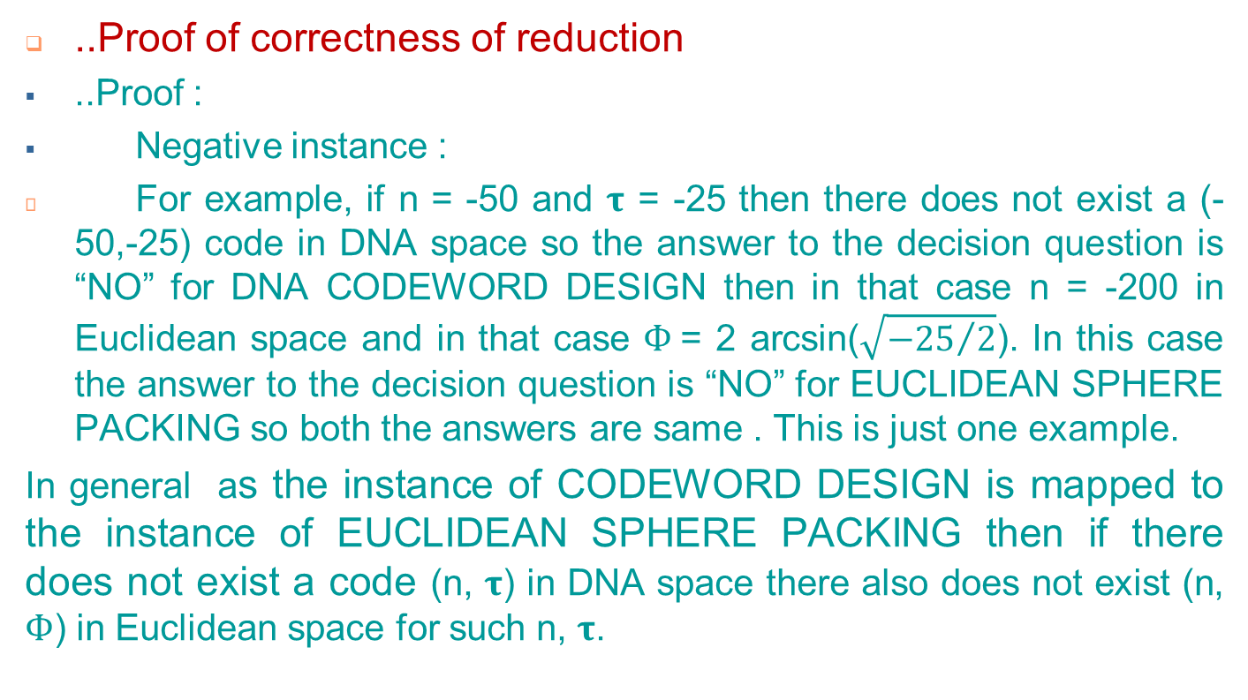
..Deliverables

Slide 24
..Deliverables

Slide 25
..Deliverables
Complexity Analysis of Algorithmic problem
To solve the complexity of the problem here decision version of the CODEWORD DESIGN problem is taken into account.
The decision version of the CODEWORD DESIGN problem is NP- complete.
Proof of NP :
To prove that this problem is in NP there needs to be sown how the TM works.
The TM M works as follows:
Nondeterministically guesses no of probes say m
Nondeterministically guesses m DNA strings of length n for potential (n, 𝛕)

Slide 26
..Deliverables
..Complexity Analysis of Algorithmic problem
..Proof of NP :
3. Compute h-distance between any pairs of those probes and checks if the h-distance is at least 𝛕
4. Checks the no of probes is less than k or not
When the machine computes the h-distance between first pair of those m probes and if the h-distance is at least 𝛕 then the machine goes for next pair and computes the h-distance and if it is also at least 𝛕 and the machine will continue and if the condition for h-distance at least 𝛕 satisfies for all of the pairs then the machine will clear the work tape, print “YES” and halt. The machine will also check that the number of probes is less than k or not if it is less than k then the machine will clear the work tape, print “YES” and halt.

Slide 27
..Deliverables
..Complexity Analysis of Algorithmic problem
..Proof of NP :
If there does not exist such no of probes where the h-distance between every pair of probe is not 𝛕 then the machine will print nothing, clear the work tape and halt and if the no of probes is not less than k then the machine will print nothing, clear the work tape and halt. It means there does not exist such lucky run.
Resource = Number of calls to compute h-distance
Input size n = n (size of the string)
Time complexity, t_{n} = O (n²k²)
Which is nondeterministic polynomial time. So, time complexity of this problem is in NP.

Slide 28
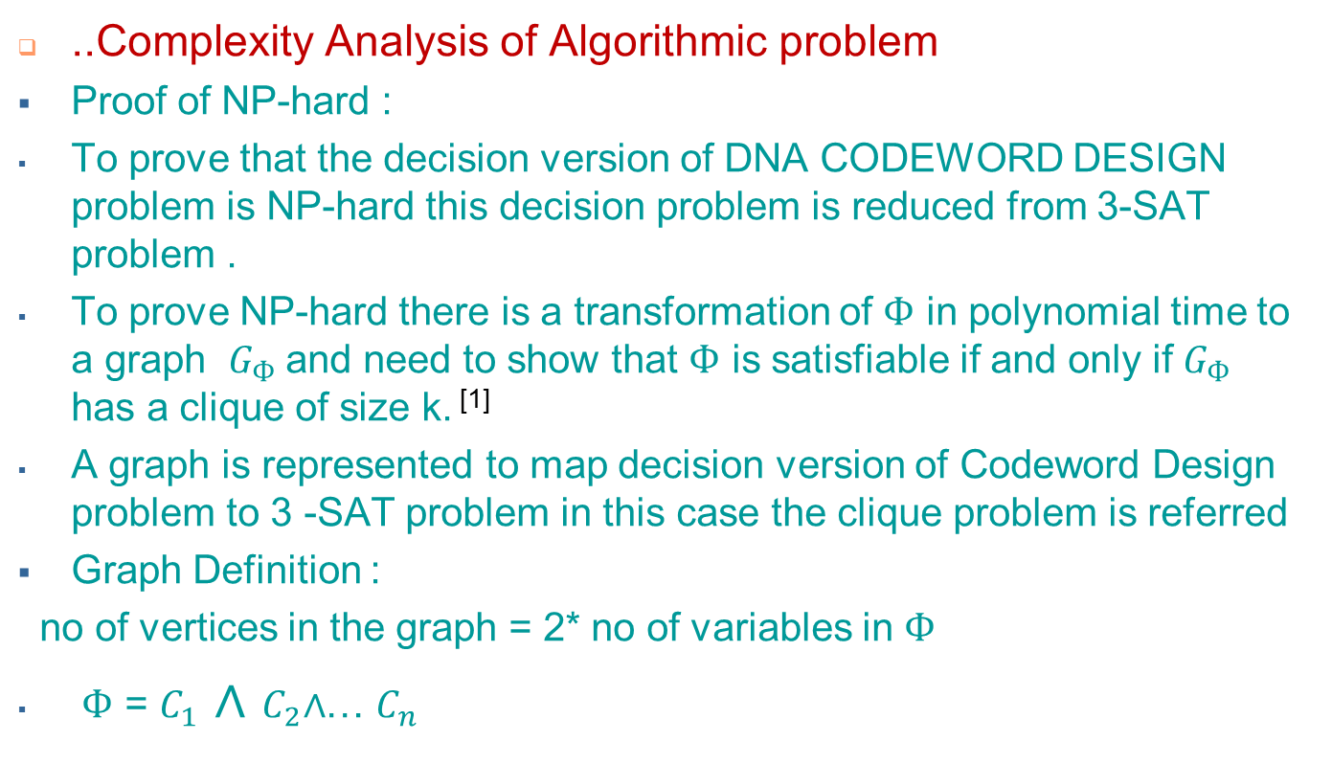
..Deliverables
^{[1]} Garzon, M., and V. Phan.3 (2009). On codeword design in metric spaces, Natural Computing, pp. 571-588

Slide 29
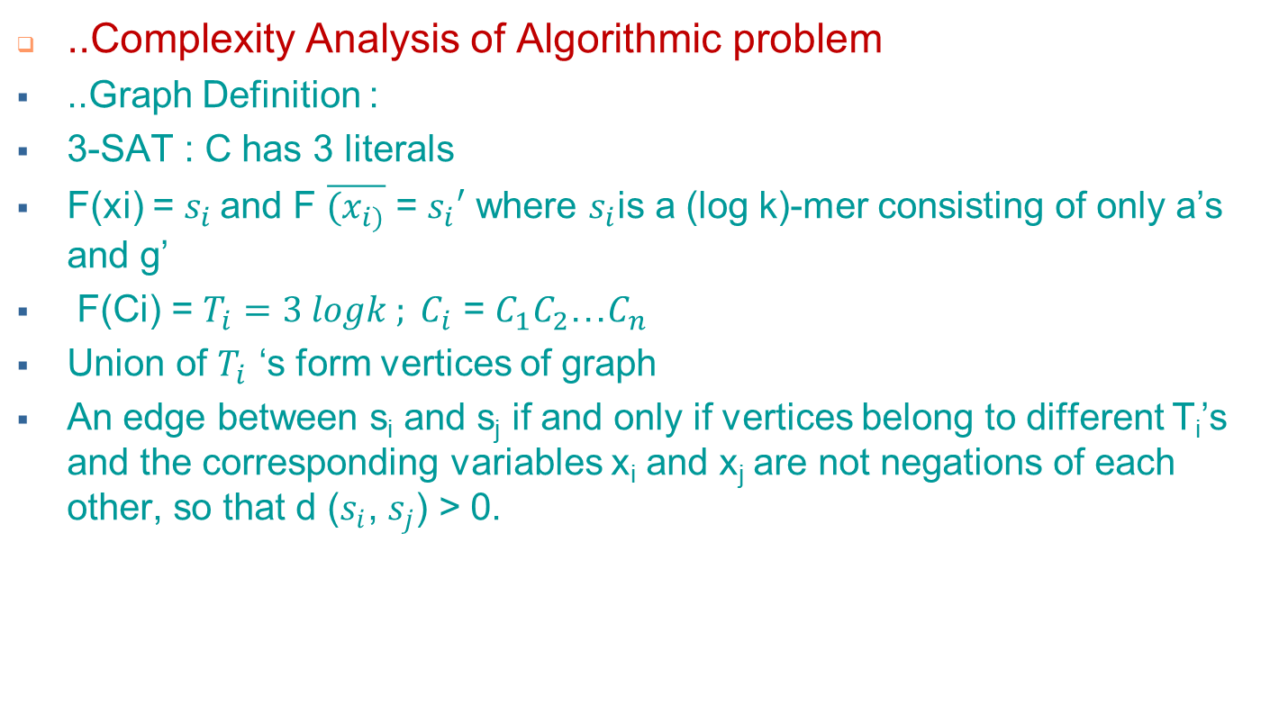
..Deliverables

Slide 30
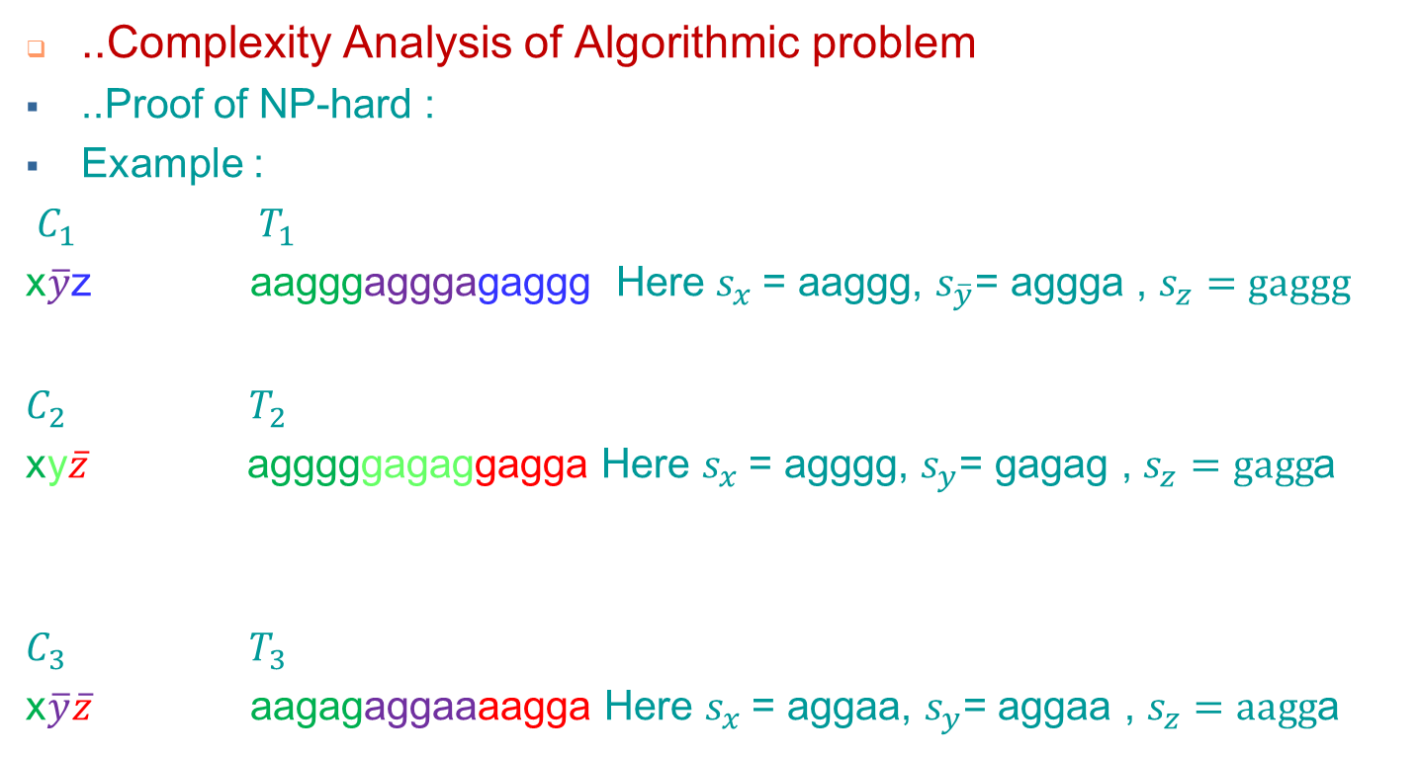
..Deliverables

Slide 31



..Deliverables
..Complexity Analysis of Algorithmic problem
Proof of NP-hard :
..Example : (For convenience, no of vertices = 3 shown here)
DNA SPACE
aagggagggagaggg
aagagaggaaaagga
.
.
agggggagaggagga.
.
.
.
.
.
K = clique size = 3
.
.
.

Slide 32
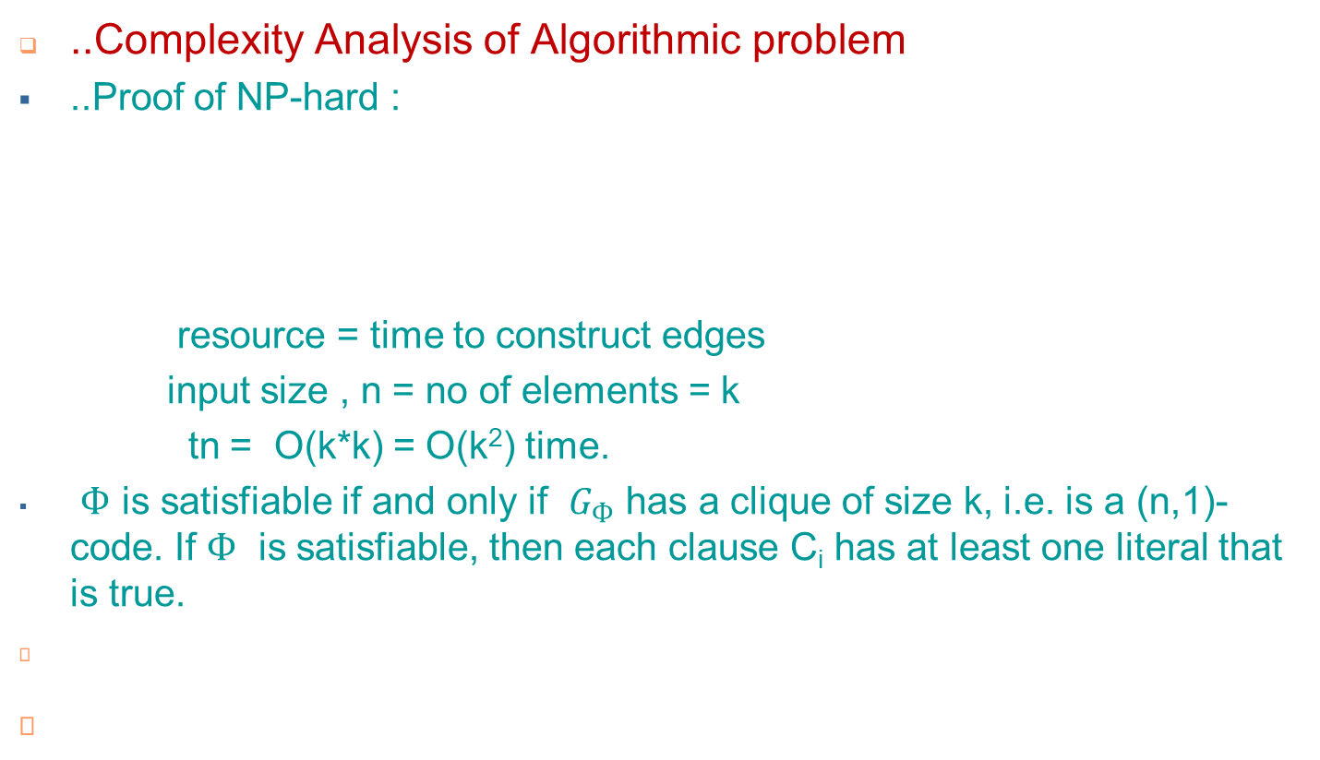
..Deliverables
A clique of size k corresponds to an (n,1)-code of cardinality k where (n,1) means a set of oligo nucleotides and the difference between any two DNA strands is at least 1.

Slide 33
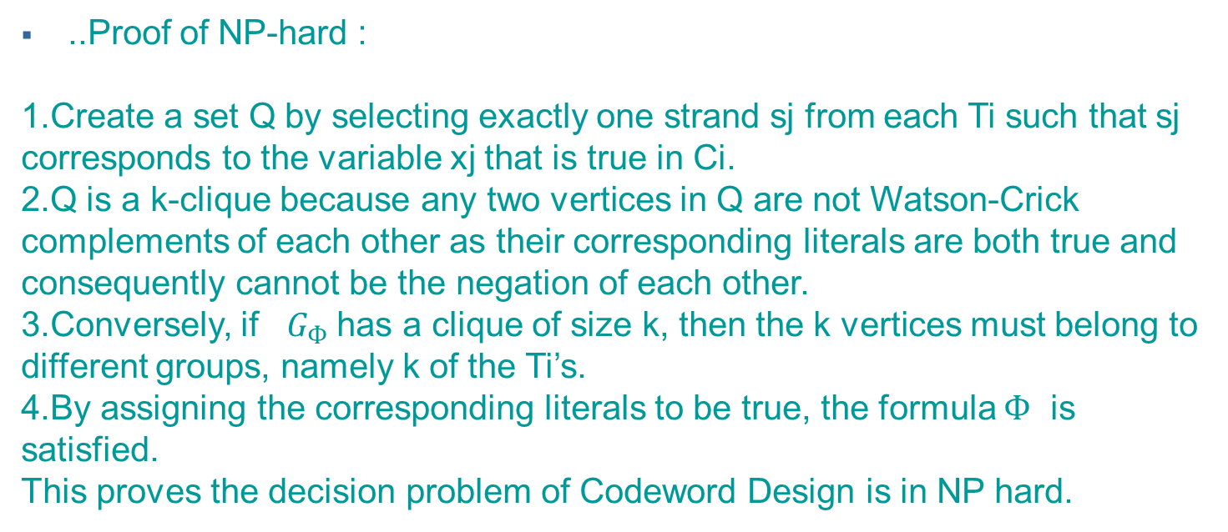
Deliverables
..Complexity Analysis of Algorithmic Problem

Slide 34
..Deliverables
..Complexity Analysis Algorithmic problem
CODEWORD DESIGN problem is in NP and at least as hard as SAT problem. So, this problem is NP-complete.
Deterministic time complexity:
In this situation there can be three types of scenario:
There may be exist a solution but researchers are not able to find it
There does not exist a solution
We do not know if there exist a solution or not
In this case the deterministic complexity is - we do not know if there exist a solution or not.

Slide 35
References
Resources
“On codeword design in metric spaces”. ^{[1]}
“DNA codeword design: Theory and applications”. ^{[2]}
“A Geometric Approach to Gibbs Energy Landscapes and DNA Oligonucleotide Design” ^{[3]}
These sources has been used as needed to complete this project successfully.
^{[1]} Garzon, M., and V. Phan.3 (2009). On codeword design in metric spaces, Natural Computing, pp. 571-588
^{[2]} Garzon, M. H. (2014). DNA codeword design: Theory and applications. Parallel Processing Letters, 24(02), 1440001.
^{[3]} Garzon, Max H., and Kiran C. Bobba 6 (2012). A geometric approach to Gibbs energy landscapes and optimal DNA codeword design, International Workshop on DNA-Based Computers Springer/Berlin, pp. 73-85

